Slide 1
Tracking Time in Harvest
General guidelines
Entry examples by job type
PTO (Personal Time Off) tracking and reporting instructions

Slide 2
Required inputs:
Minimum 35 hours Billable per week
Weekday holidays choose “Holiday” vs. “No time tracked”
PTO (Personal Time Off) enter as “Vacation”
Enter all items separately – do not group multiple activities in one entry
Note “Billable” hours include all meetings, including 1:1
See next slides for input guidelines by job description

Slide 3
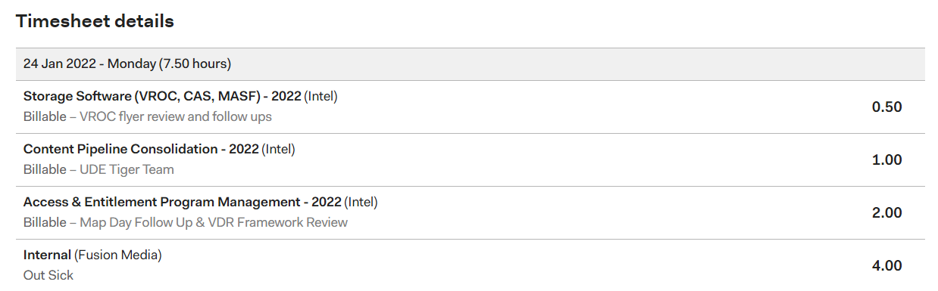
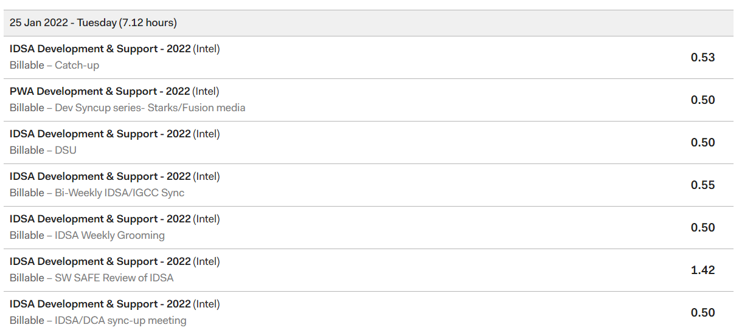
Project Manager Timesheet
Programmer Timesheet

Slide 4
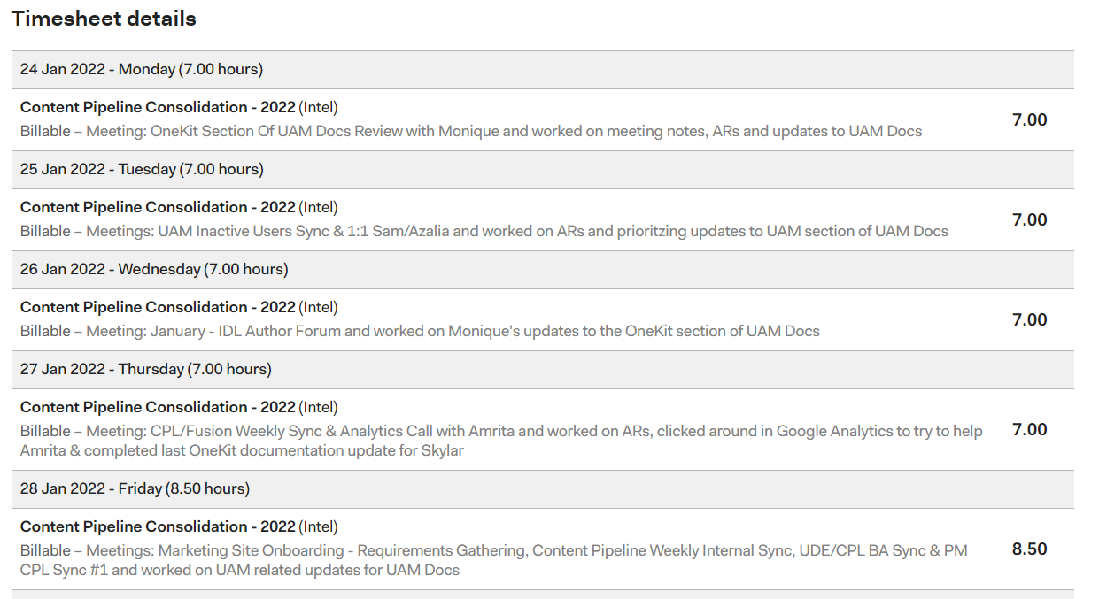
Analyst Timesheet

Slide 5
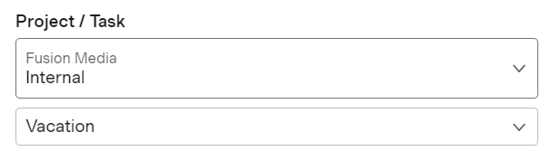
PTO (Personal Time Off) Tracking and Reporting
Enter all time off using “Internal for Project / Task and “Vacation” from the dropdown menu:
Track PTO to date:
Go to Reports > Detailed time, filter by the specific task(s) or project (in this case, "Vacation," and then set the timeframe to 'This year'. You should then be able to see all of your own tracked time off for the year to date.

